Slide 1


TRAILBot Real-Time Trail Segmentation
Andres Cervera Rozo & Mehtab Malik

Slide 2
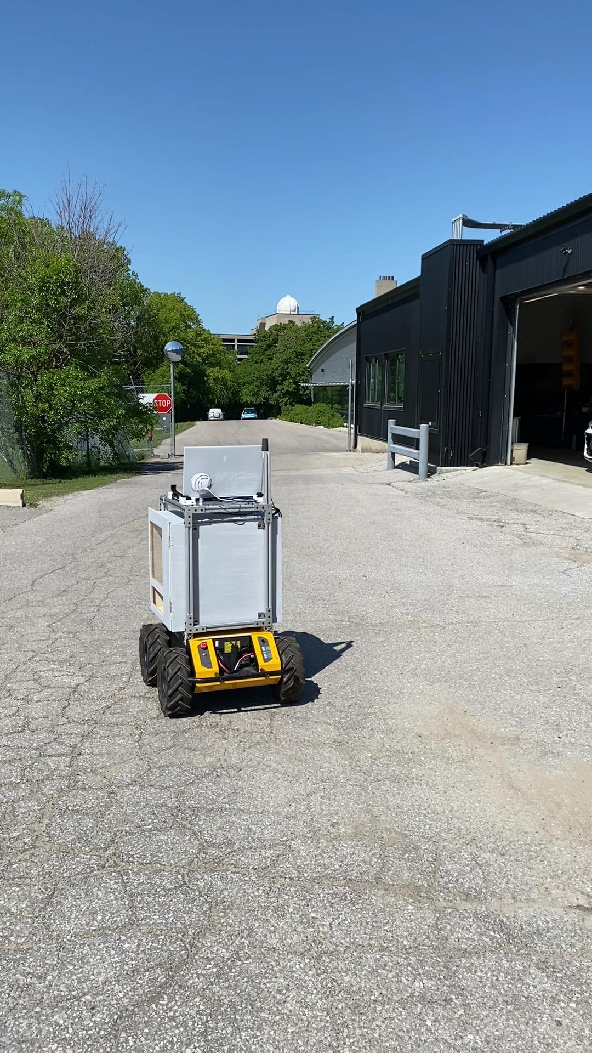
Motivation
Baseline Solution
Limitations
TRAIL Lab robot to distribute treats to hikers
Semantic segmentation of hiking trails
Trained on PSPNet with custom dataset (~1000 images)
Dataset is overfit to 1 long trail
PSPNet semantic segmentation model is no longer state-of-the-art
Inconsistent results (mIoU)

Slide 3
Objectives
Robustness
Speed
Accuracy
Adaptability to perform effectively in various environmental/trail conditions
Ability to segment incoming video stream frames in real-time
Ability to correctly identify and label the trail boundaries

Slide 4
Methodology
Dataset Expansion
Data Augmentation
Collect and segment 400 images of various trails (asphalt, concrete, dirt, gravel)
Augment data using mirroring, scaling, cropping, and gaussian blurring techniques
Architecture Adjustment
Hyperparameter Tuning
Explore state-of-the-art segmentation models for optimal performance
Tune the highest performing architecture hyperparameters (epochs, learning rate, batch size)

Slide 5
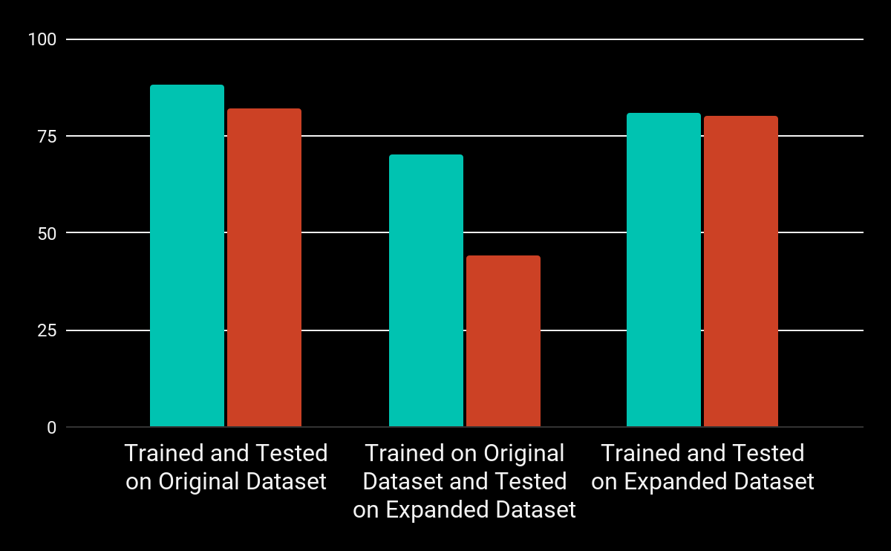
Dataset Expansion
PSPNet + ResNet-50
Pixel Accuracy
Percentage of pixels that are accurately classified in the image
mIoU
Percentage of overlap between the predicted segmentation and the ground truth segmentation

Slide 6
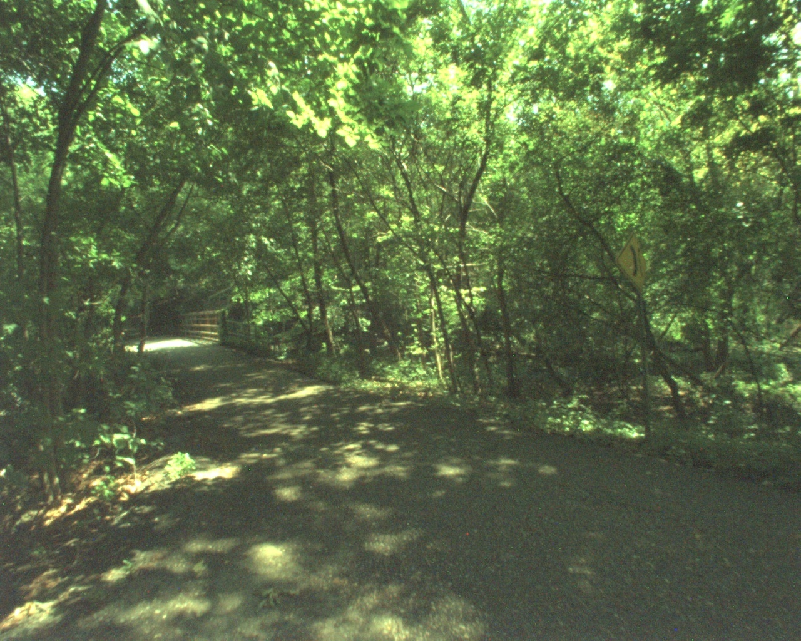
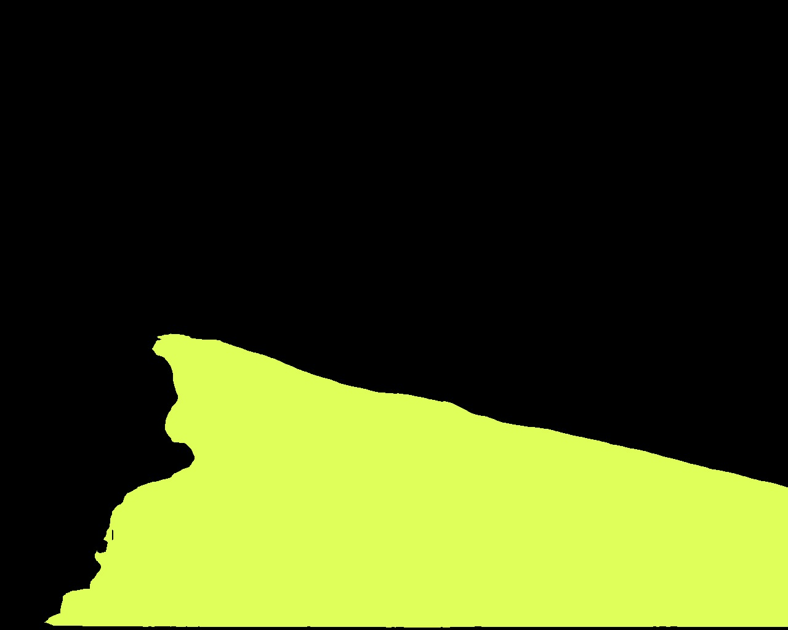


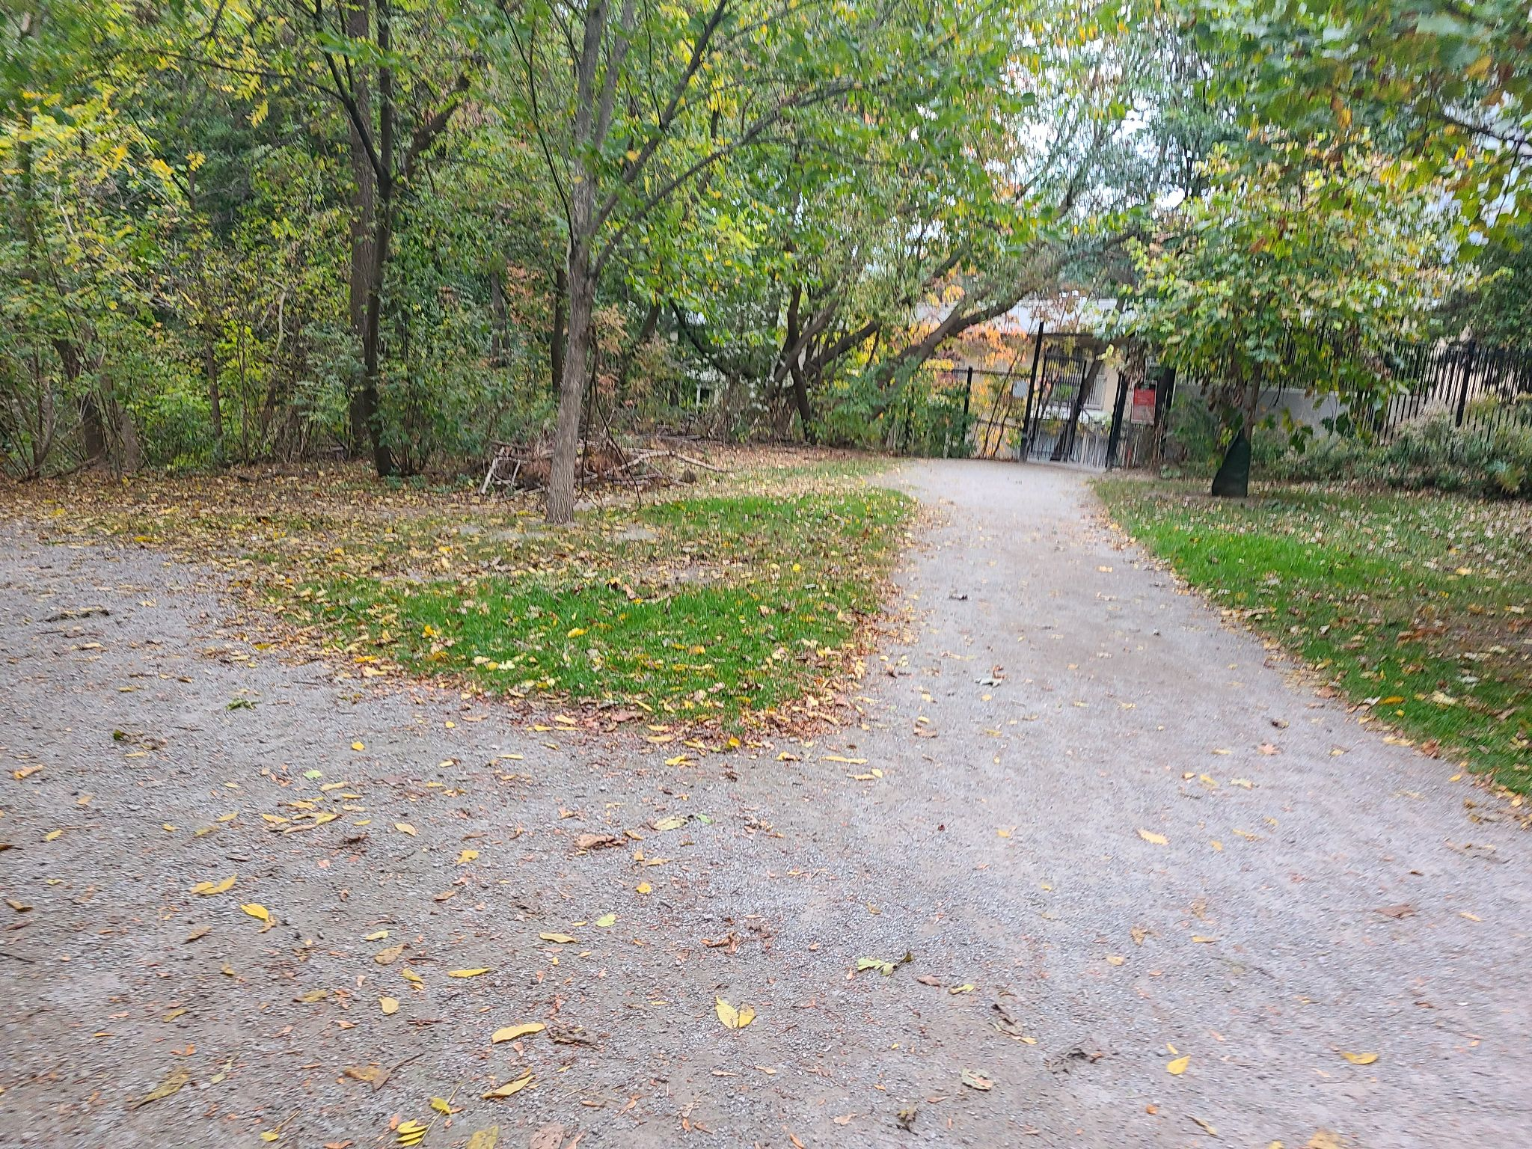
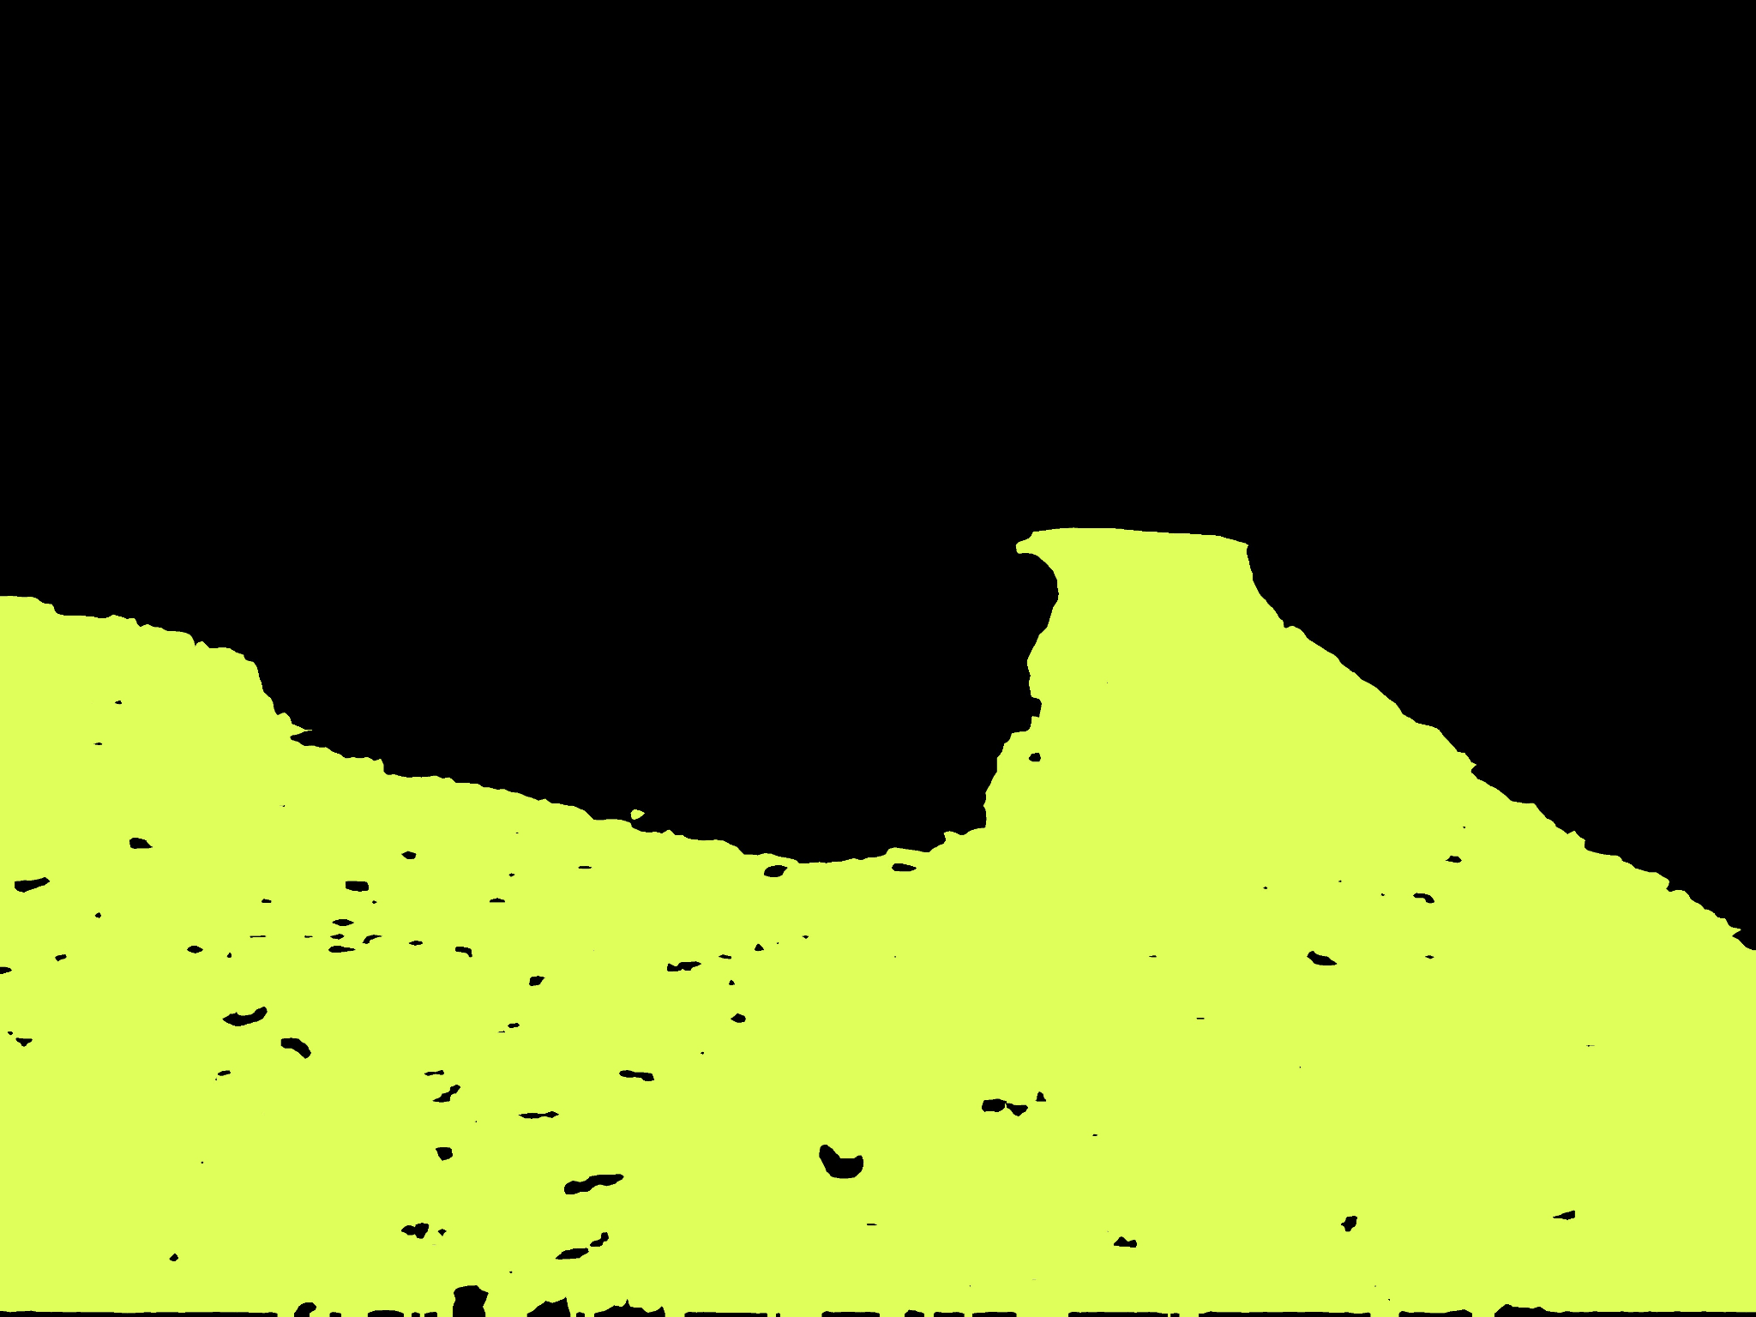


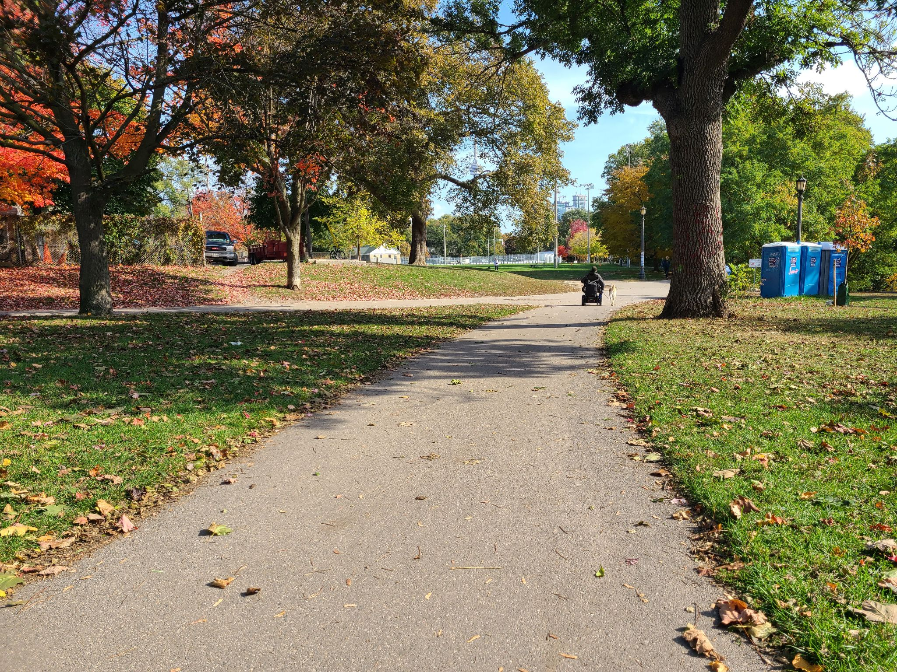
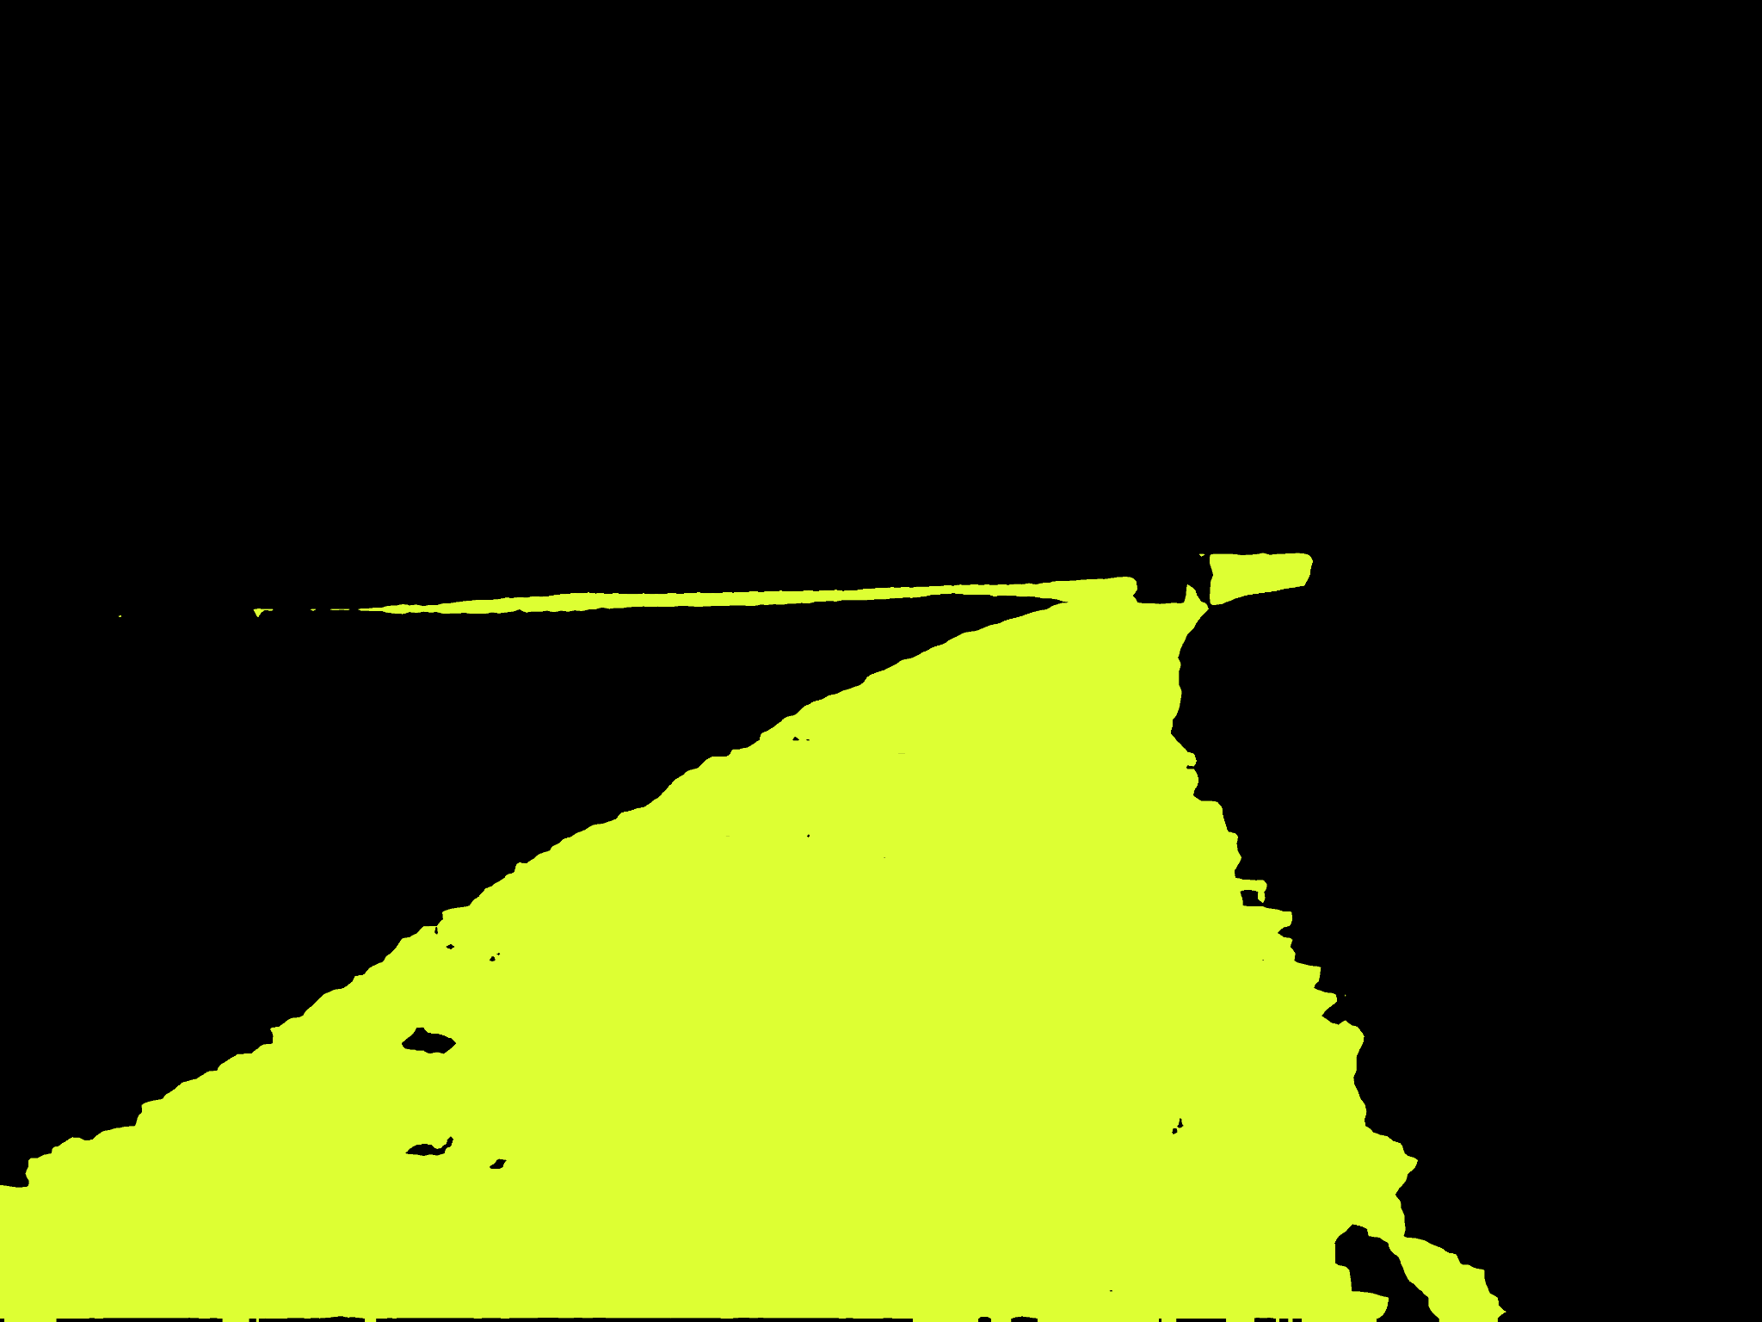

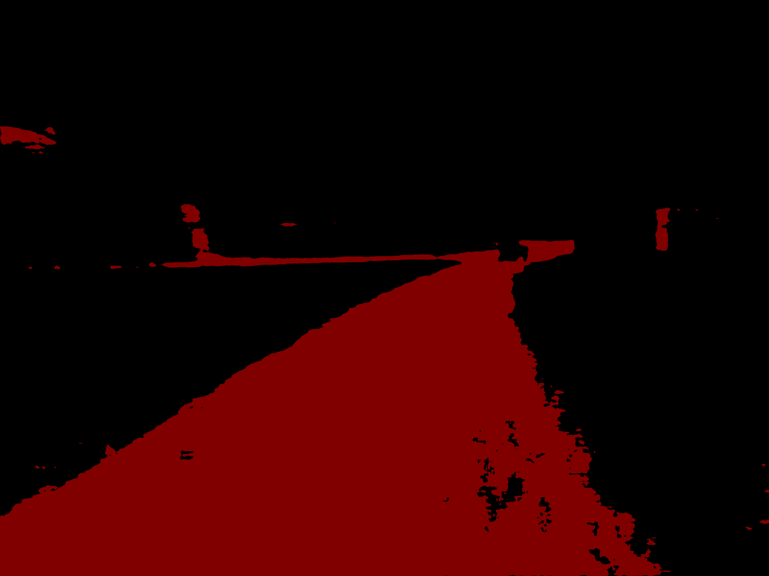
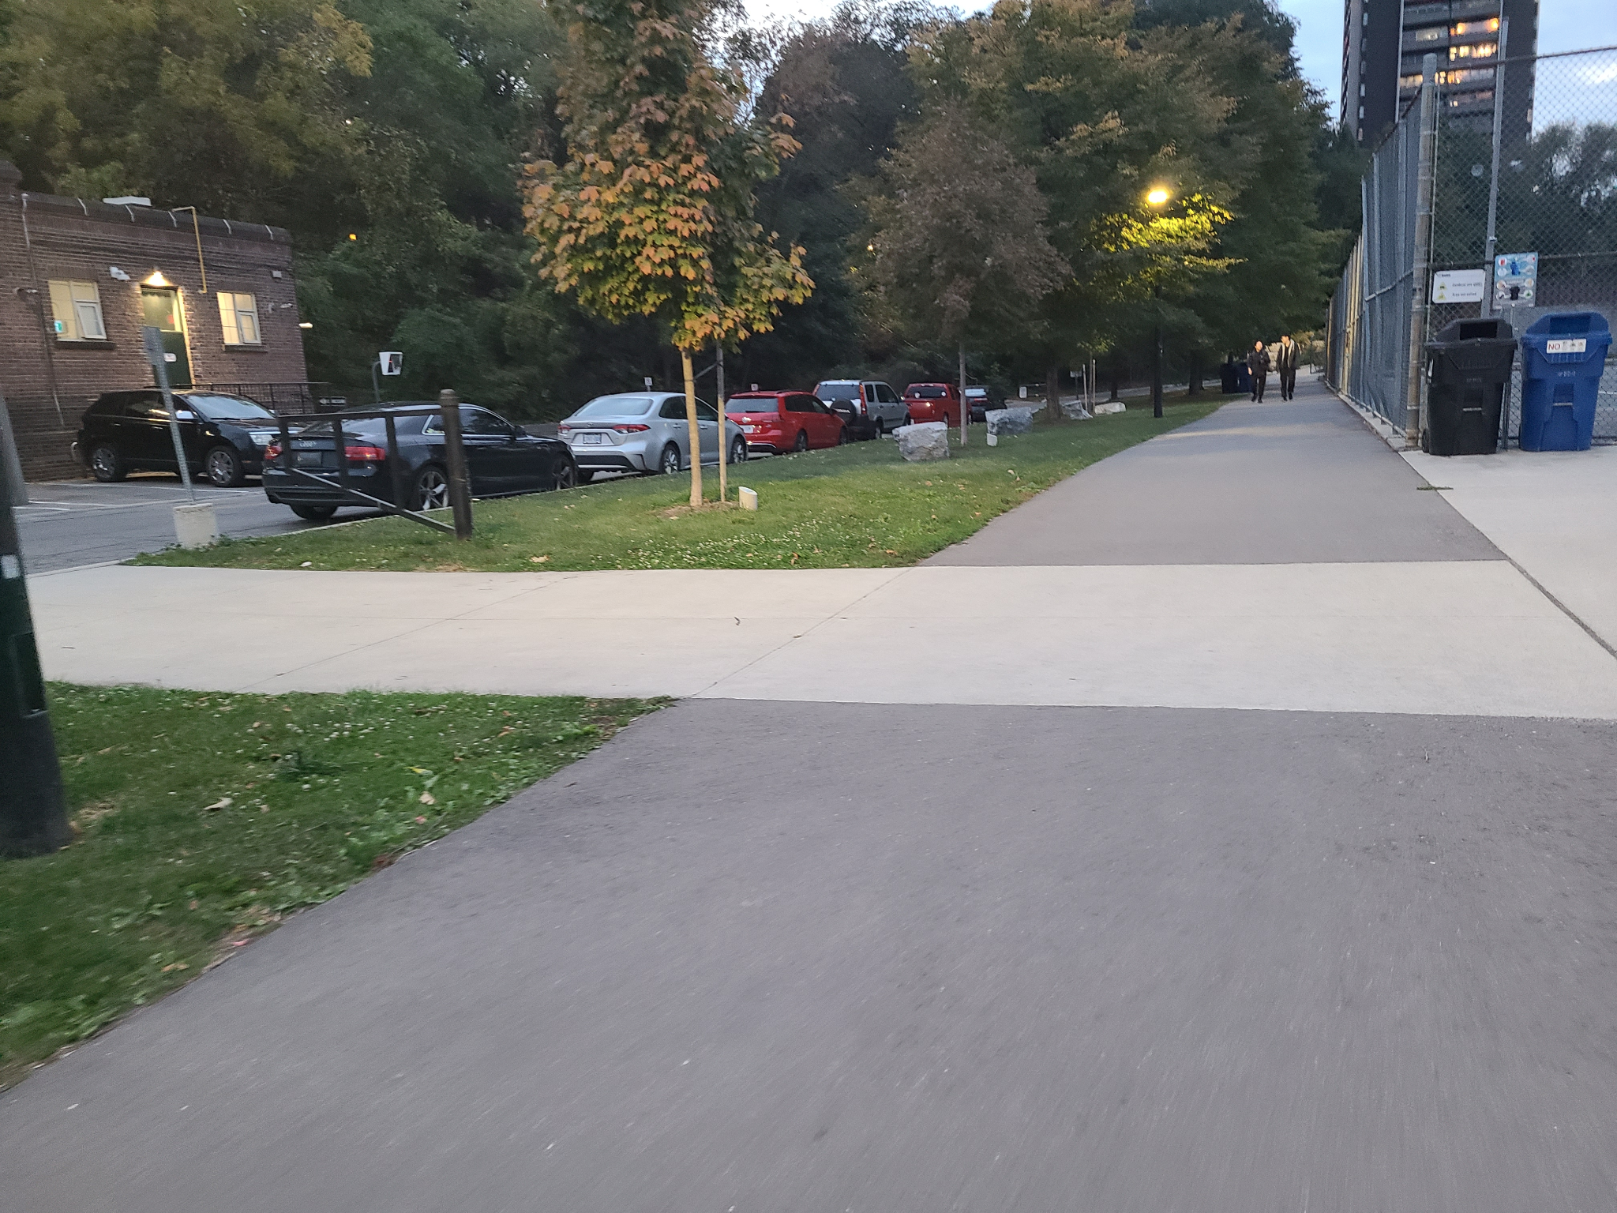



Trail
Ground Truth
Old Prediction
New Prediction

Slide 7

Data Augmentation
Mirror
Crop
01
03
Scale
Gaussian Blur
02
04
Flip the image along its vertical axis
Extract a portion of the image
Resize the image while maintaining its aspect ratio
Blur the image to reduce noise and suppress detail

Slide 8

Architecture Selection
Performance: How does the model perform on segmentation tasks with existing popular datasets (e.g. Cityscapes or COCO)?
Runtime: Is this approach appropriate for real-time online applications on mobile robot?
Computation Required: How many weights need to be optimized? Is this feasible with only 1 GPU?
PyTorch Compatibility: How complex is it to integrate these models with PyTorch? Are there licensing issues?

Slide 9


Model Results
Performance
LEDNet + ResNet-50
87.79%
PSPNet + ResNet-50
86.62%
DeepLabV3 + ResNet-50
85.30%
BiSeNet + ResNet-18
84.09%
ICNet + ResNet-50
82.23%
A Lightweight Encoder-Decoder Network for Real-Time Semantic Segmentation

Slide 10
Hyperparameter Tuning
LEDNet + ResNet-50 (Before Tuning Hyperparameters)
Learning Rate | Batch Size | Epochs | Performance
0.003 | 8 | 10 | 87.79%
LEDNet + ResNet-50 (After Tuning Hyperparameters)
Learning Rate | Batch Size | Epochs | Performance
0.004 | 4 | 30 | 89.38%

Slide 11

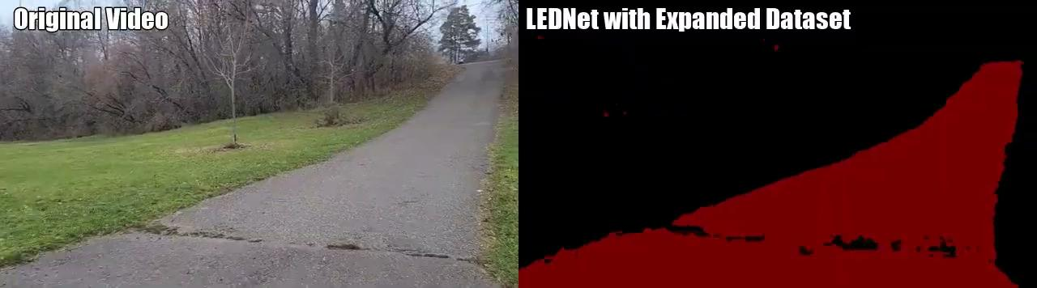
Video Demo

Slide 12
THANKS!

